Slide 1
Theory status and prospects for the muon g-2 (/2 = a_{μ})
Tom Blum (UConn/RBRC)
Bay Area Particle Theory Seminar
March 5, 2021

Slide 2
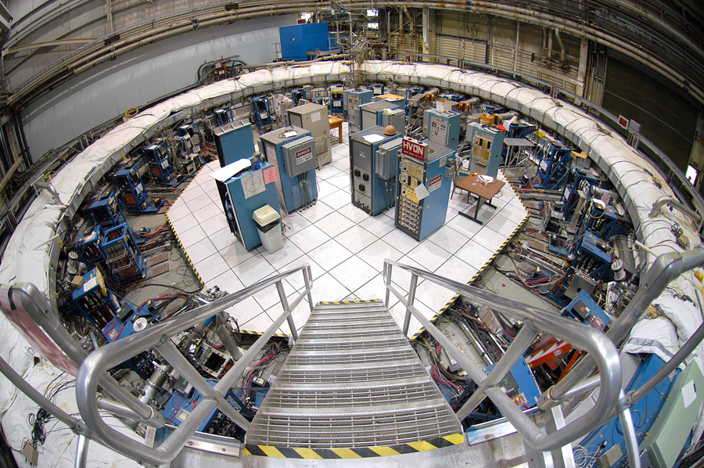
BNL E821 Measurement
a_{μ} = 116592089(63) 10⁻¹¹ (0.54 ppm)

Slide 3
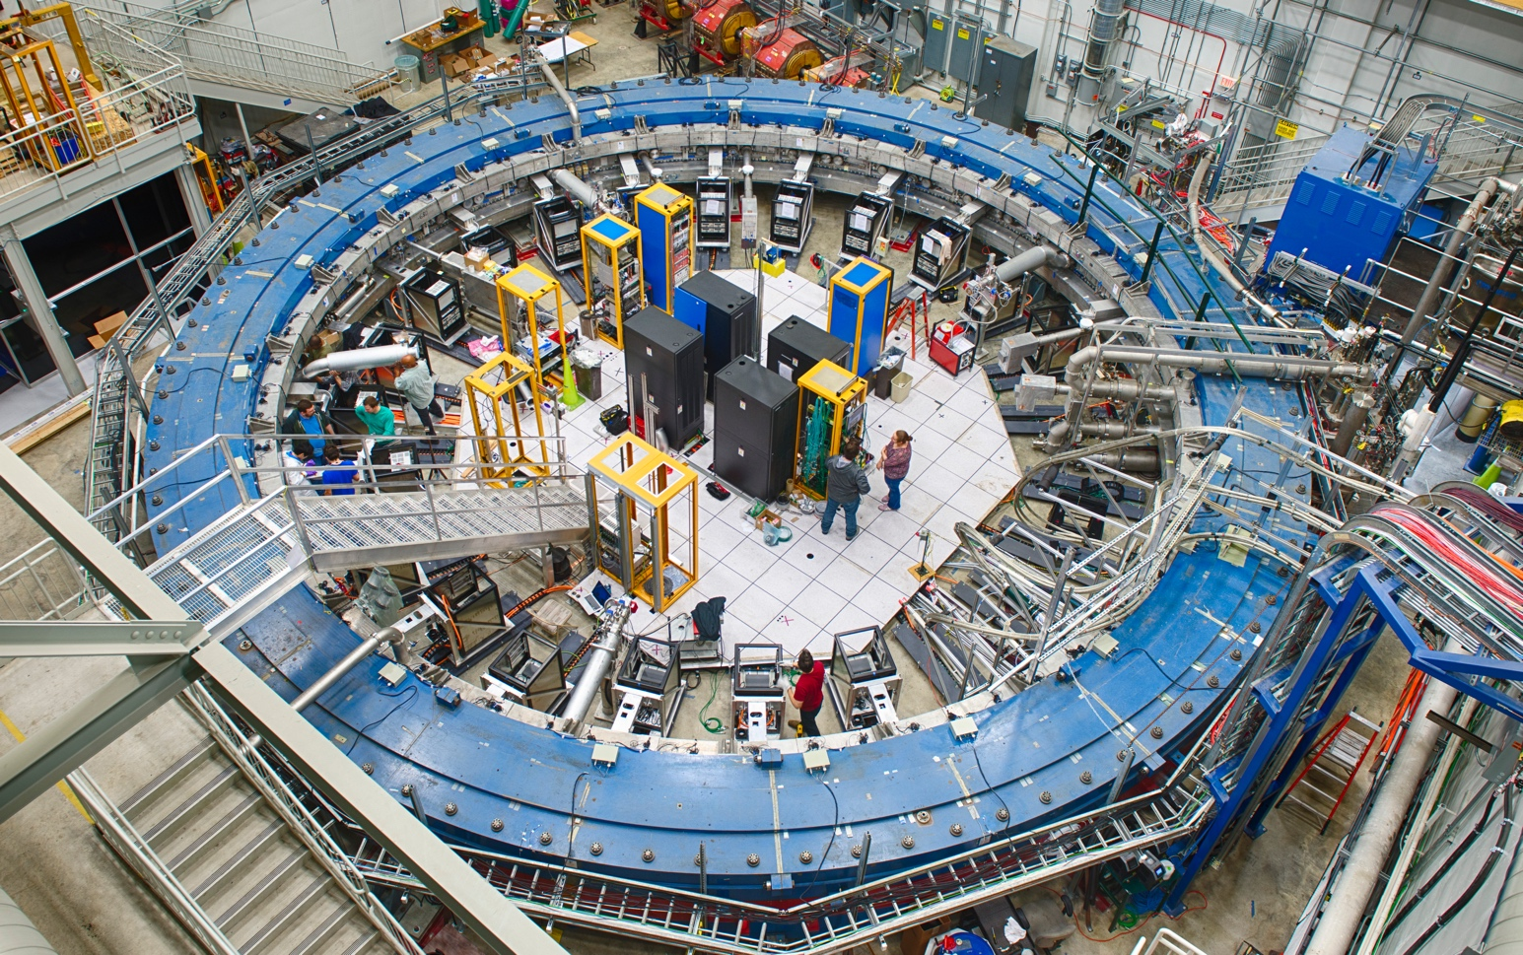
the Muon g-2 experiment at fermilab
a_{μ} = ?
Peter Winter
High Energy Physics Division
Argonne National Laboratory
Notes:
Storage ring experiment, inject muons into ring, uniform B perp to ring, decay to e+ v in direction of spin,

Slide 4
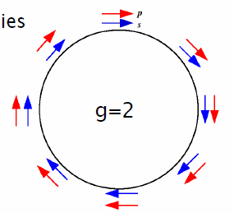
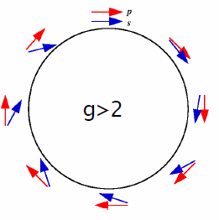
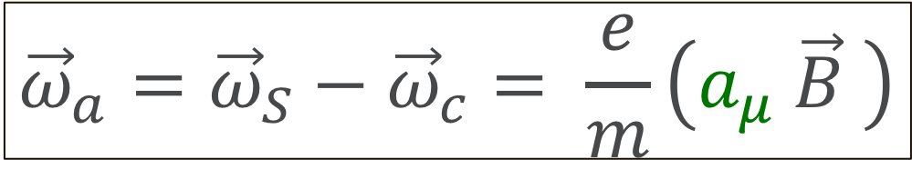
Muons in a storage ring
Cyclotron frequency:
Spin precession frequency:
Larmor + Thomas precession
$${\vec{ω}}_{a}={\vec{ω}}_{S}−{\vec{ω}}_{c}= \frac{e}{m}\left(a_{μ} \vec{B} \right)$$

Slide 5
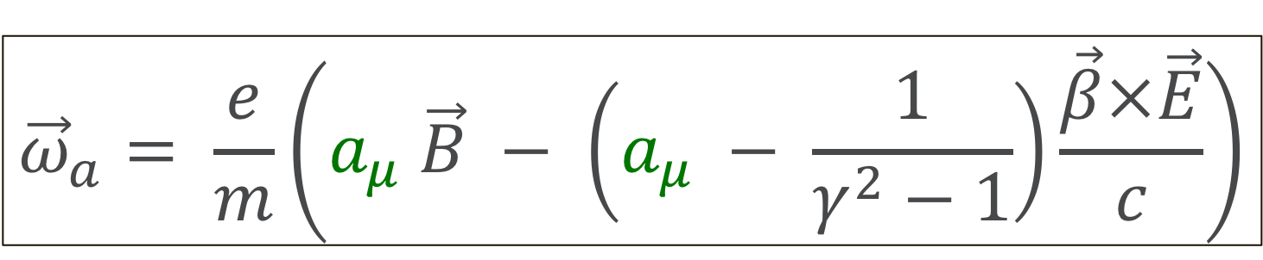
Muons in B and E field
In presence of additional E-field:
Measuring the anomalous moment a_{μ} requires both
  the spin precession frequency ω_{a}
  the magnetic field B (through NMR spectroscopy of proton)
$${\vec{ω}}_{a}= \frac{e}{m}\left(a_{μ} \vec{B} − \left(a_{μ} − \frac{1}{γ^{2}−1}\right)\frac{\vec{β}×\vec{E}}{c}\right)$$
Magic momentum (γ = 29.3, p=3.094 GeV/c)
E field for vertical focusing
CERN-III, BNL E821, Fermilab E989
No E field: E = 0
Weak magnetic focusing
J-PARC E34
ω_{a} = e/m a_{μ} B

Slide 6
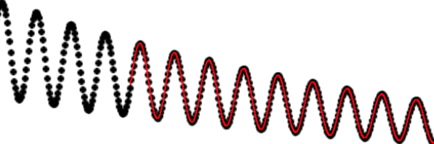
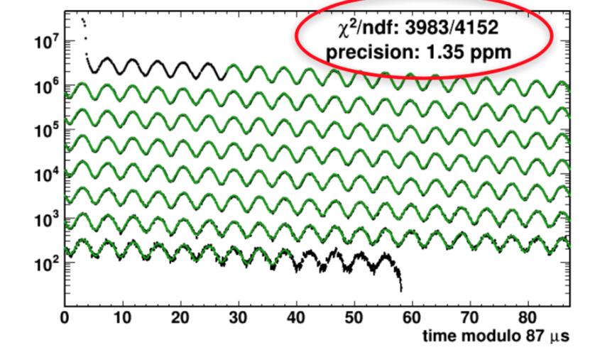
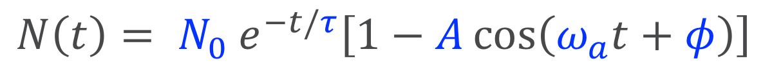
Run-1 analysis status: ω_{a}
Simple 5-parameter fit captures the main features of the “wiggle plot”:
$$N\left(t\right)= N_{0} e^{−t/τ}\left[1−A\cos\left(ω_{a}t+φ\right)\right]$$
PRELIMINARY

Slide 7
Run plan and expected statistics
Goal is to reduce total uncertainty by factor of 4 over E821 (BNL)7 0.54 ppm

Slide 8
Muon g-2/EDM
experiment
at J-PARC
Features:
Low emittance muon beam (1/1000)
No strong focusing (1/1000) & good injection eff. (x10)
Compact storage ring (1/20)
Tracking detector with large acceptance
Credit: T. Mibe

Slide 9
Theory v. experiment (muon g-2 theory initiative baseline)
From T. Teubner:

Slide 10
magnetic moment of free muon is $spin ×\frac{e }{2m}$ g, g=2

Slide 11
Muon g-2 Theory Initiative
(2006.04822 [hep-ph])
0.54 PPM
0.37 PPM

Slide 12
Hadronic vacuum polarization (HVP) I: data driven (e⁺e⁻)
Credit: T. Teubner
Magnetic part:

Slide 13
a_{μ}-HVP from data
More precise than lattice determination. Total error larger than DHMZ and KNT separately.
Data from BABAR, BESIII, CMD-2, KLOE, SND
“Merged” value from DHMZ, KNT, and CHHKS (simple average in each channel for central value, conservative combination of errors). Errors statistical and systematic

Slide 14
Data sets disagree outside of quoted errors, leads to differences in analysis too.
Some differences cancel in integrated quantities

Slide 15
a_{μ}-HVP from data
Prospects for improvement:
              Better/more analysis of existing data (BABAR, KLOE)
              More data from CMD-3, Belle II, BESIII, BESCII, SND
              Include τ-decay data when isospin breaking properly understood (lattice may help)

Slide 16
Hadronic vacuum polarization II: Lattice QCD
RBC/UKQCD 2018
Calculate C(t) on 4d
Euclidean space-time lattice
Notes:
Euclidean space time lattice for HVP, quarks props: large sparse matrix, gluons: MC integration of gauge fields

Slide 17
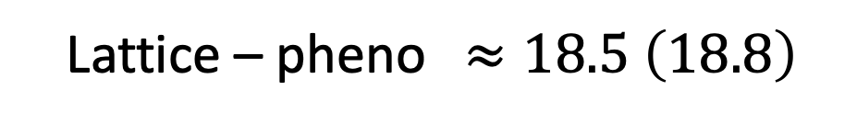
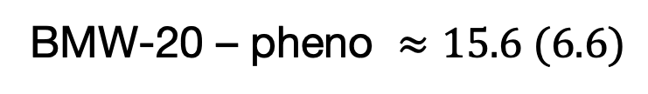
a_{μ}-HVP from Lattice QCD+QED
(0.75%)
HVP (BMW-20): a_{μ} = 7087 (53) x 10⁻¹⁰
(2.6%)
HVP (Lattice): a_{μ} = 7116 (184) x 10⁻¹¹
(0.58%)
HVP (pheno): a_{μ} = 6931 (40) x 10⁻¹¹
Lattice – pheno $≈18.5 \left(18.8\right)$
BMW-20 – pheno $≈15.6 (6.6)$
17

Slide 18
The connected light quark contribution
BMW-20 634.6 (2.7)(3.7)
add 18.1(2.0)(1.4) for FVE
a_{μ}^{HVP, ll} = 650.2 (11.6) x 10⁻¹⁰
Large spread ~630-675 x 10⁻¹⁰
(Does not include BMW-20)
State-of-the-art is to use physical quark masses
(Significant chiral extrap in ETM and Mainz/CLS)
18

Slide 19
Long distance contributions and the statistical error
Correlator reconstruction: Mainz, RBC/UKQCD
Aubin, et al.-19
m_{π} =133 MeV
Mainz-19
m_{π} =200 MeV
Low Mode Average: RBC/UKQCD-18,
Aubin, et al.-19, BMW-20 (C(t) averaged
over all EM current source-sink pairs)
Dominated by two pion states at large time

Slide 20
Bounding method
Original method:
BMW-17,20, RBC/UKQCD-18
Mainz-19, RBC/UKQCD: Improved method
using long distance correlator reconstruction
A. Meyer, et al.
RBC/UKQCD (preliminary)
t/a
t/a
(much) Shorter distances possible
Fit method
FHM-19, ETM-19
FHM-19
Statistical error 6x smaller
replace data beyond t*
with multi-exponential,
multi-operator fit
RBC/UKQCD (preliminary)
20

Slide 21
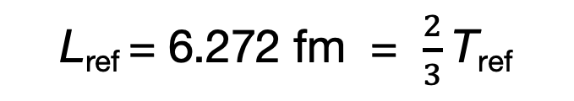
BMW-20 continuum extrapolation ( M_{Ω} + w₀)
a_{μ} + a² (+a⁴)
634.6 (2.7)(3.7)(0.5)(...) x 10⁻¹⁰ (stat, taste, CL, …)
L_{ref} = 6.272 fm = $\frac{2}{3}$T_{ref}
(FV correction 18.7(2.5), IB 5.7(…))
w₀ = 0.17236(29)(63) fm
(0.4%)

Slide 22

RBC/UKQCD-18 continuum limit ( M_{Ω} )
a_{μ}$+ a2$
More than doubled statistics on current ensembles
Improved bounding method
Estimate sub-percent total error with these improvements
Need to add 3rd lattice spacing to reach 0.7 % error
a⁻¹ = 1.730 GeV results differ by a few
percent from continuum limit
2.7 GeV lattice underway to compliment
1.730, and 2.359 GeV
(strange quark contribution)
Light quark: 647.9 (14.2)(2.8)(1.5)(3.7)(…) x 10⁻¹⁰ (statistical, a⁴, scale setting, FV, …)
total: 705.9 (14.6)(2.9)(1.8)(3.7)(…) x 10⁻¹⁰ (statistical, a⁴, scale setting, FV, …)

Slide 23
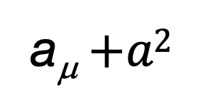
Aubin, et al.-20 continuum limit ( f_{π} + w₀, from FHM 19)
(Light quark contribution)
a_{μ}$+a2$
Fit
FV + taste
More than doubled statistics on finest ensemble
Improved low-mode average on finest ensemble
Added new coarsest ensemble
Adding statistics for two finest ensembles
Aiming for 1% total
FV + taste + m_{p} mis-tuning
no correction
FV
taste symmetry breaking large
corrected at NLO in SChPT
651 (20)(5)(5) x 10⁻¹⁰
Statistical, CL fit, scale setting (includes NLO taste breaking (and FV) corrections)

Slide 24
Disconnected contributions
More groups needed
Includes strange contribution [Mainz]
Statistical and systematic errors important
BMW 20 -13.15(1.28)(1.29)

Slide 25
Isospin symmetry breaking corrections

Slide 26
Isospin symmetry breaking corrections
Collaboration | QED |  |  | Strong IB
 | V+S (+S_{T}) |  | F (+D3) | M | O
BMW-20 | -1.27(40)(33) |  | -0.55(15)(11) | 6.59(63)(53) | -4.63(54)(69)
ETM-19 | 1.1(1.0) |  |  | 6.0(2.3)
RBC/UKQCD-18 | 5.9(5.7)(…) |  | -6.9(2.1)(1.4)(…) | 10.6(4.3)(…)
FHM-19 |  |  |  | 1.5(7) % a_{μ}^{ll}
LM-20 |  |  |  | 9.0(0.8)(1.2)
statistical errors large (except BMW-20, LM-20)
Spread is relatively large
FV effects can be very large (e.g., see LM-20)
large cancelations

Slide 27
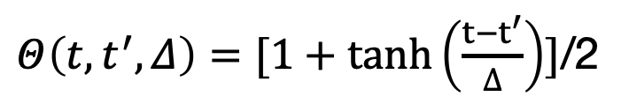
Towards precise comparisons: the window method
[RBC/UKQCD-18]
November 2020 workshop on HVP, Harmut Wittig
Staggered results lie above DWF, R-ratio
Conserved v. local currents
More groups need to investigate
Gradually increase size of window
Compare with R-ratio (e.g., investigate BaBar KLOE discrepancy)
$Θ\left(t,t^{′},Δ\right)=[1+tanh\left(\frac{t−t^{′}}{∆}\right)]$/2
Aubin, et al.-19
RBC/UKQCD-18
KNT-19 – lattice s, c, …
(ud connected, 0.4 – 1.0 fm window)

Slide 28
Strange and charm contributions
Seem to be in good shape
BMW-20 53.393(89)(68)
BMW-20 14.6(0)(1)

Slide 29
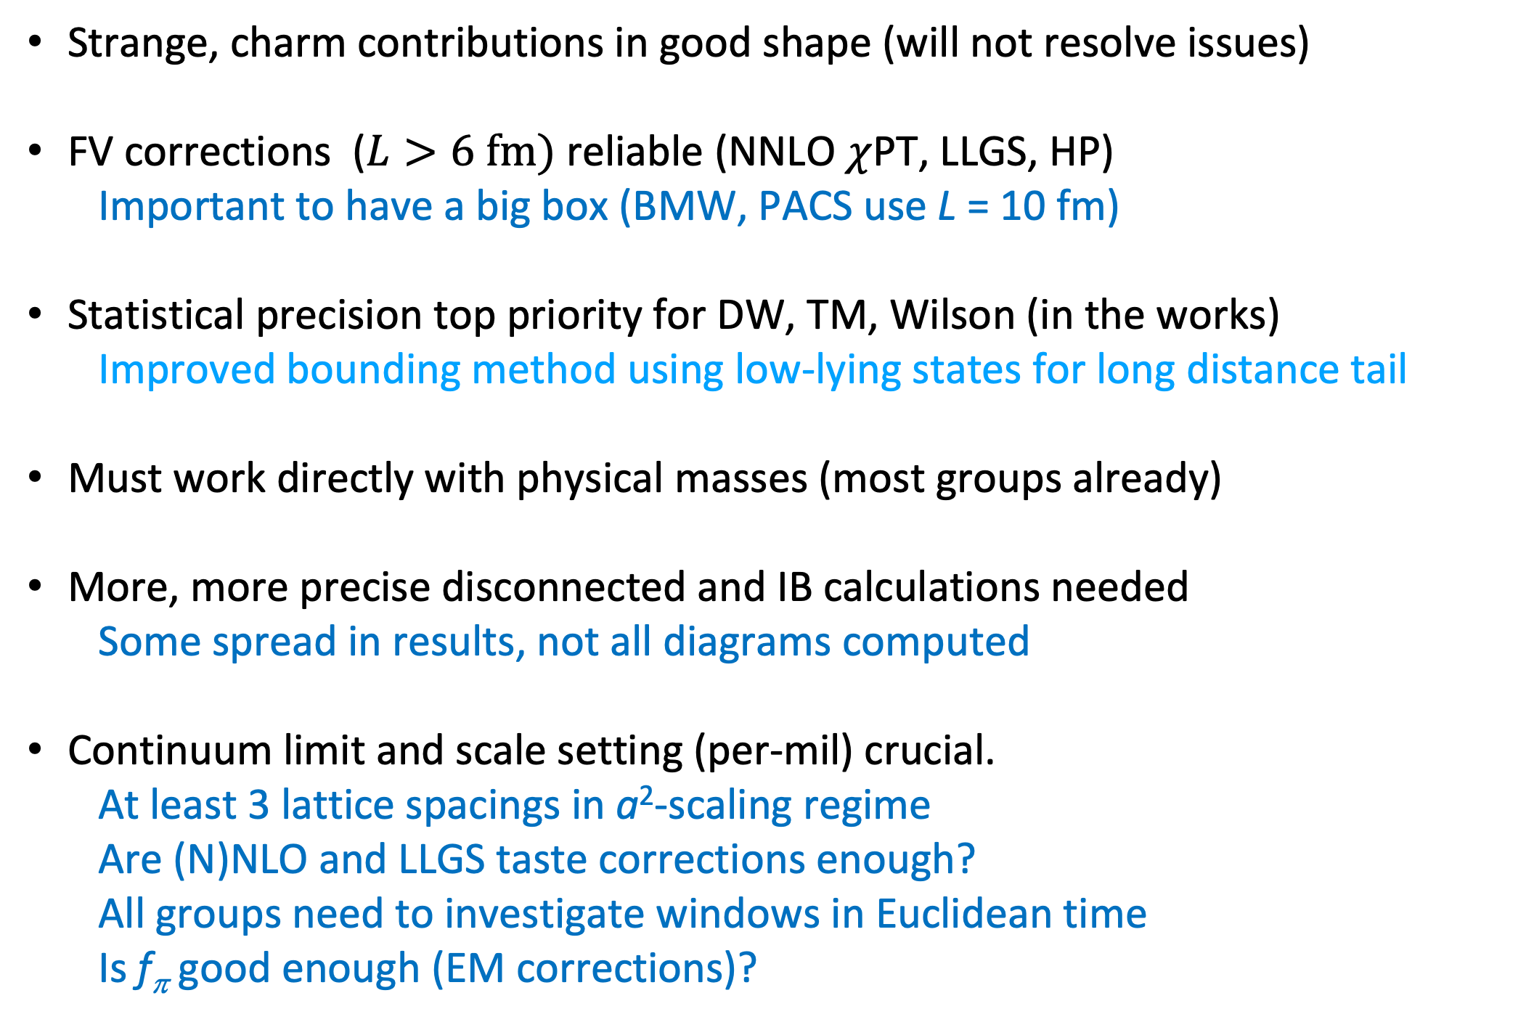
To reach desired precision (2-5 per-mil?)
Strange, charm contributions in good shape (will not resolve issues)
FV corrections ($L>6 fm)$ reliable (NNLO $χ$PT, LLGS, HP)
            Important to have a big box (BMW, PACS use L = 10 fm)
Statistical precision top priority for DW, TM, Wilson (in the works)
  Improved bounding method using low-lying states for long distance tail
Must work directly with physical masses (most groups already)
More, more precise disconnected and IB calculations needed
  Some spread in results, not all diagrams computed
Continuum limit and scale setting (per-mil) crucial.
  At least 3 lattice spacings in a²-scaling regime
  Are (N)NLO and LLGS taste corrections enough?
  All groups need to investigate windows in Euclidean time
  Is f_{π} good enough (EM corrections)?

Slide 30
a_{μ}-HLbL from data and models
Good agreement between
data/dispersive and lattice approaches

Slide 31
a_{μ}-HLbL from data and models
Huge improvement in pole contributions
All contributions computed or estimated
Errors added in quad for dispersive results
Errors added linearly for model-dependent results

Slide 32

Lattice HLbL
Blum, et al. (RBC) PRL 124 (2020)
Editor’s Suggestion
$$a_{μ}^{HLBL}=7.87±3.06±1.77×{10}^{−10}$$
RBC: first lattice calculation with all errors controlled.
1 G core-hours on ALCF’s Mira (BG/Q).
1st HLbL calculation was done on USQCD resources (Blum, et al., PRL 114 (2015))
Crucial for Standard Model Comparison
Included in Muon g-2 Theory Initiative average
  92(19)x 10⁻¹¹ (phenomenology)
  90(17)x 10⁻¹¹ (phenomenology+lattice)
Unlikely to explain discrepancy with experiment
Notes:
Consistency between lattice and pheno for both hvp and hlbl crucial for discovery of new physics

Slide 33
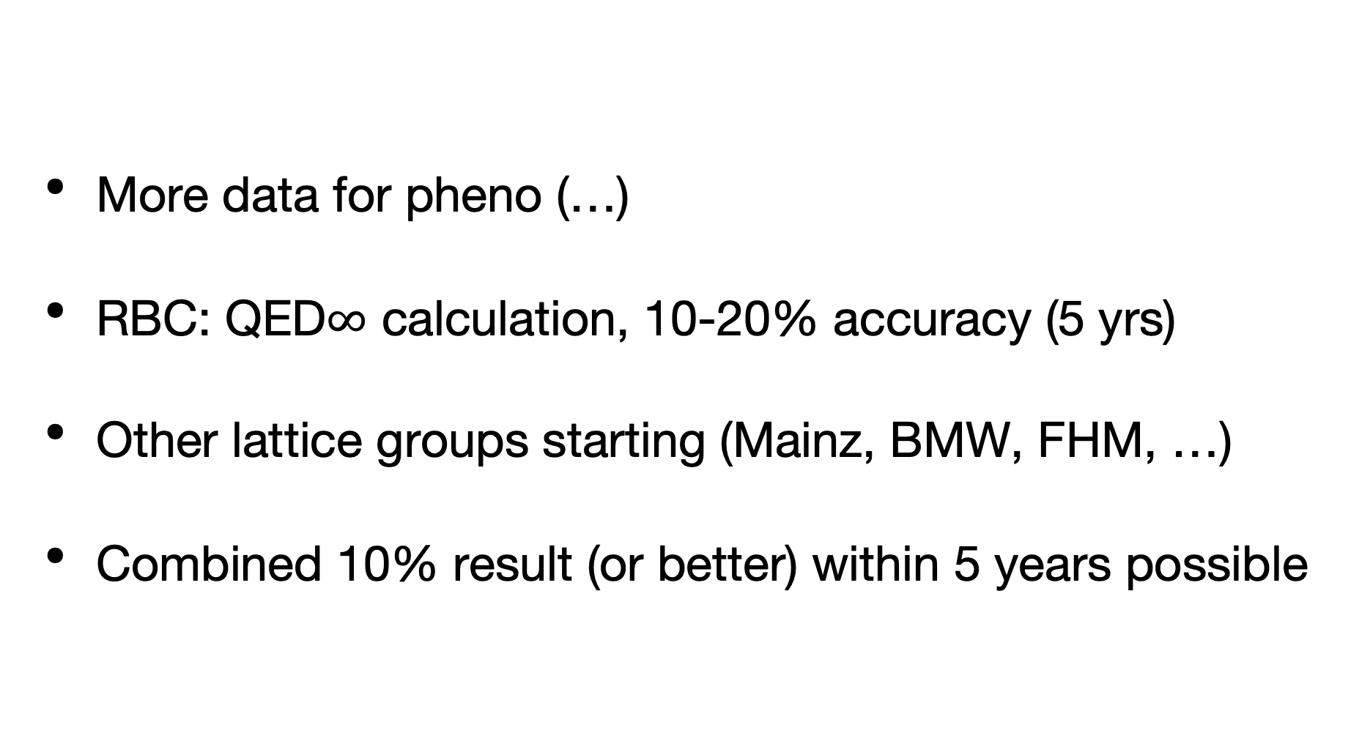
a_{μ}-HLbL outlook
More data for pheno (…)
RBC: QED$∞$ calculation, 10-20% accuracy (5 yrs)
Other lattice groups starting (Mainz, BMW, FHM, …)
Combined 10% result (or better) within 5 years possible

Slide 34
What could BSM theory look like?
Supersymmetry
Leptoquarks
Light scalar
Two higgs doublets
…

Slide 35
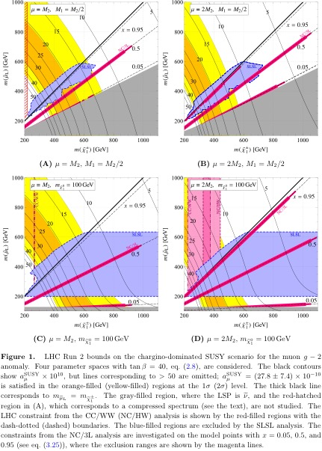
SUSY at LHC
JHEP04 (2020) 165

Slide 36
Leptoquarks
JHEP06 (2020) 089
arXiv:1905.03789

Slide 37
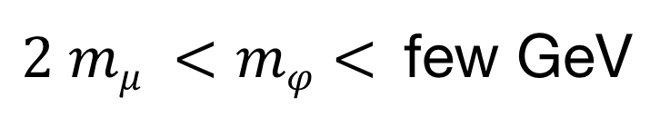
Electron g-2 and Light scalar
arXiv:1806.10252v2
New value for α leads to
2.4-σ discrepancy for a_{e}
with opposite sign to a_{μ}
Newer value knocks that
down to 1.6, same sign
$2 mμ <mφ<$few GeV

Slide 38
Outlook
SM is a remarkable success
Muon g-2 best chance for new physics
  at the moment
Fermilab Muon g-2 experiment E989
to announce 1st results very soon

